Slide 1
Interactive System Design II
Baby Monitoring System
(BMS)
Habeeb Rilwan Giwa
Supervise by
Prof, Dr, Hayek

Slide 2

Motivation

Slide 3
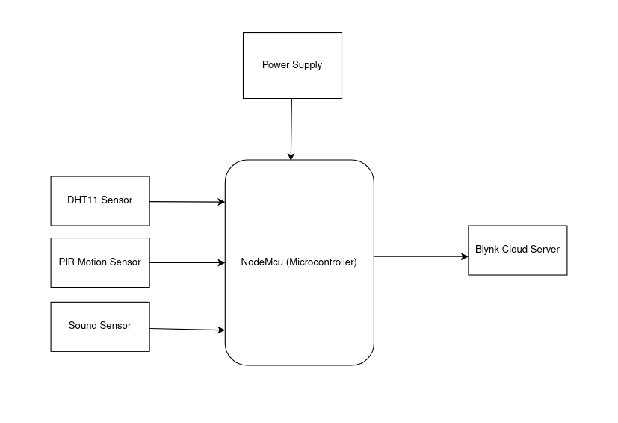
System Overview

Slide 4
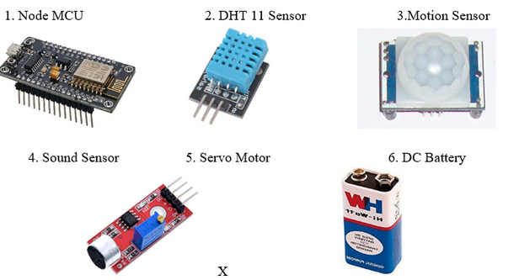
Controller and Sensors
NodeMCU: Act as the main controller.
DHT11: Monitoring temperature and humidity.
PIR Sensor: Detecting motion.
Sound Sensor: Monitoring sound levels.

Slide 5
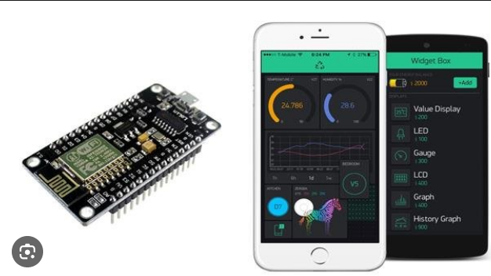
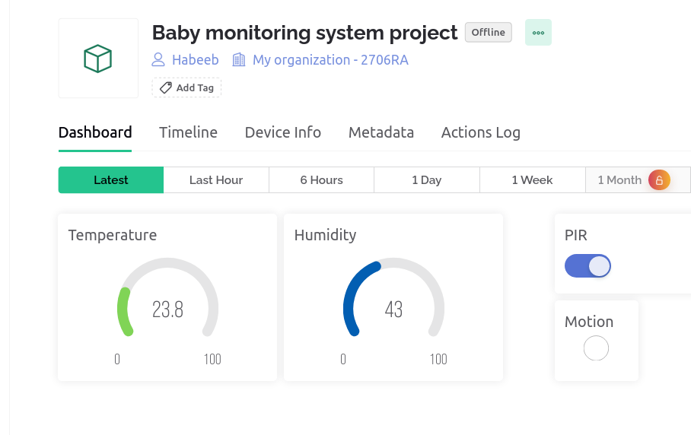
Blnyk App

Slide 6
Demo

Slide 7
Benefits
Ensuring Safety and Comfort.
Remote Monitoring.
Real-time Alerts.

Slide 8
Challanges
Power Supply.
Internet Connectivity.

Slide 9
Conclusion
The baby monitoring system is not just a technological solution but a valuable companion for modern parents seeking a balance between work and family life.

Slide 10
Thank You!!!

